Slide 1
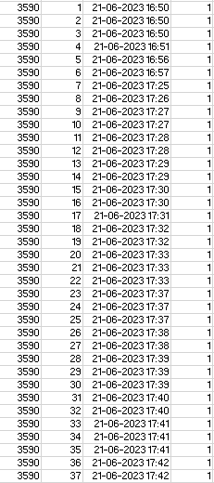
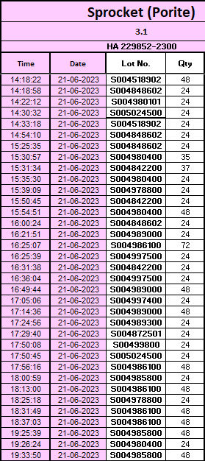
Time base logic in Step 1 → Range will be high but trace time improved. Narrow down FG range by QR on tray
FG
Trace back →From NG FG to NG lot
Lot
Trace forward →From NG lot to NG FG
FG
Performance mc
For each lot 2 time limits
Limit 1 → n+ 2 h
Limit 2 → n+ 3h 5 min
Performance mc
Model
S/n
Mfg Date Time
St no.
Washing mc lot entry
Model
S/n
Mfg Date Time
St no.
Line stoppage time 28 min
Suspected
NG lot range
Limit 1 → 17:25
Suspected NG FG range
+ 20 min
Customer
Claim
- [30 min + (3 min Tol)]
17:07
Sprocket
NG
Time Limit 2
Time Limit 1
17:17
-[20 min + (3 min Tol)]
+ 30 min+ line stoppage 28 min
Limit 2 → 18:03
Line stoppage time 28 min

Slide 2
11 Sept 5 AM
Wash
Shift Start 11 Sept 6 AM
Lot | Time
A | 5:05:00
B | 5:05:00
C | 5:05:00
D | 5:05:00
E | 5:05:00
K
G
F
Assy Line
11 Sept 6 AM
11 Sept
5:50 AM to (L2)
5:52 AM
6:00 AM From (L1)
S/n | Time
1 | 6:20:00
2 | 6:20:30
3 | 6:21:03
4 | 6:22:00
5 | 6:25:00

